Slide 1
Citizen Science trilobite ids
Improve datasets through audience participation.

Slide 2
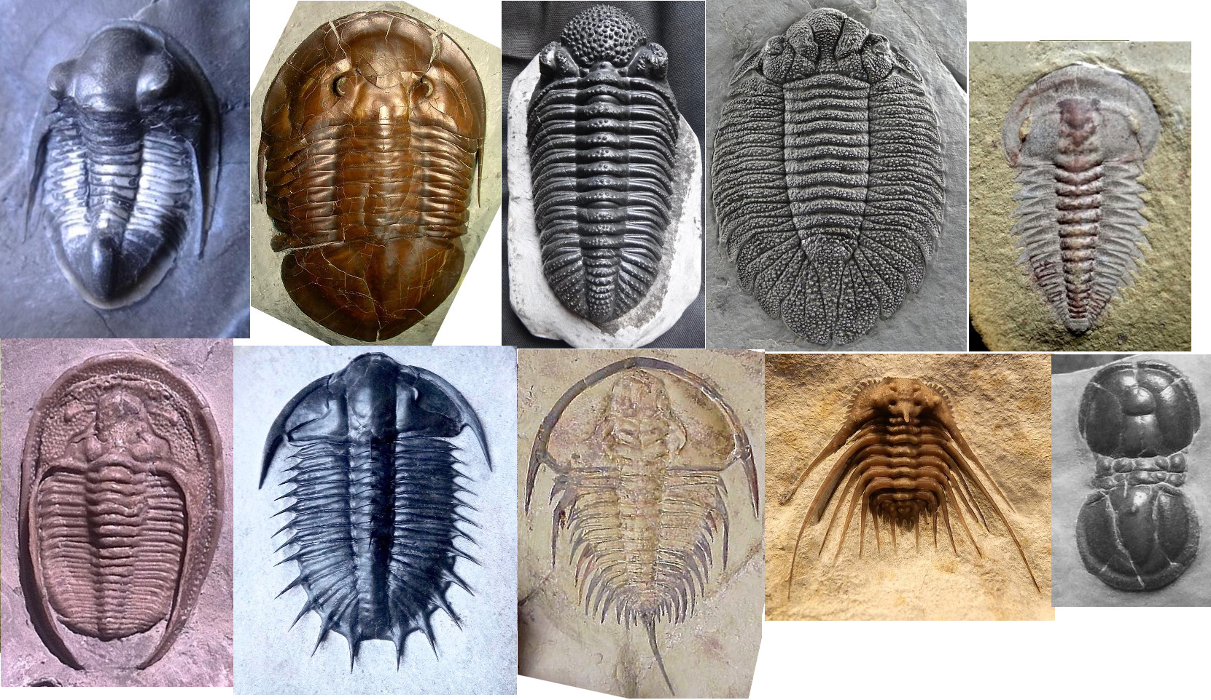
20,000 Species of Trilobites
Extinct
Diverse
Well-preserved
Adorable

Slide 3
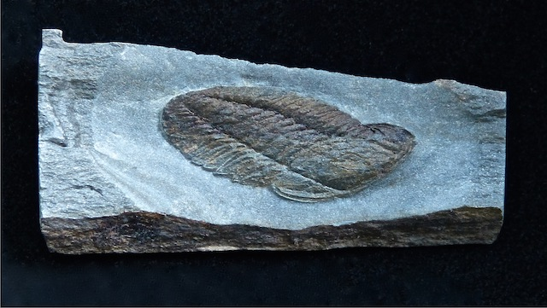
Trouble With Trilobites
Varied imaging
Incompletely/imperfectly preserved fossils
Limited-size datasets

Slide 4
Citizen Science
Zooniverse is citizen science platform
Volunteer-driven

Slide 5
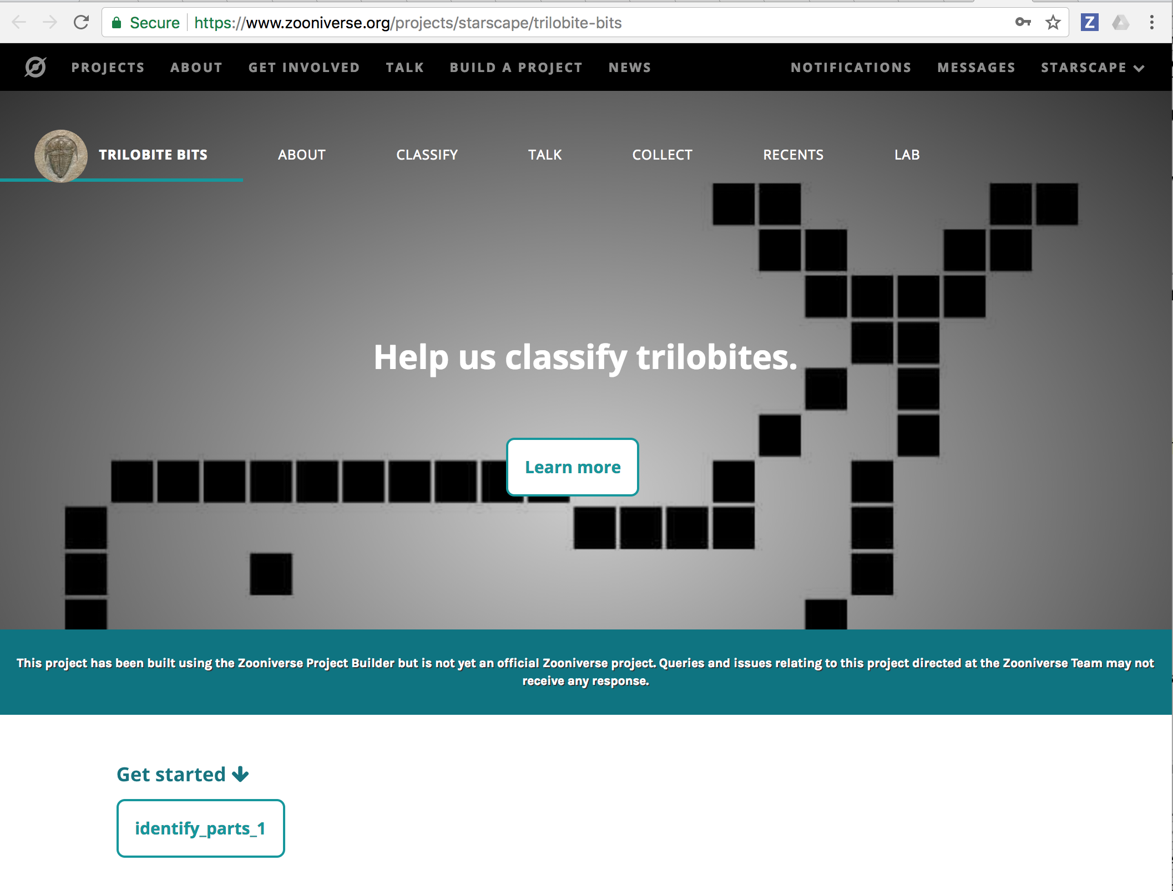

Slide 6
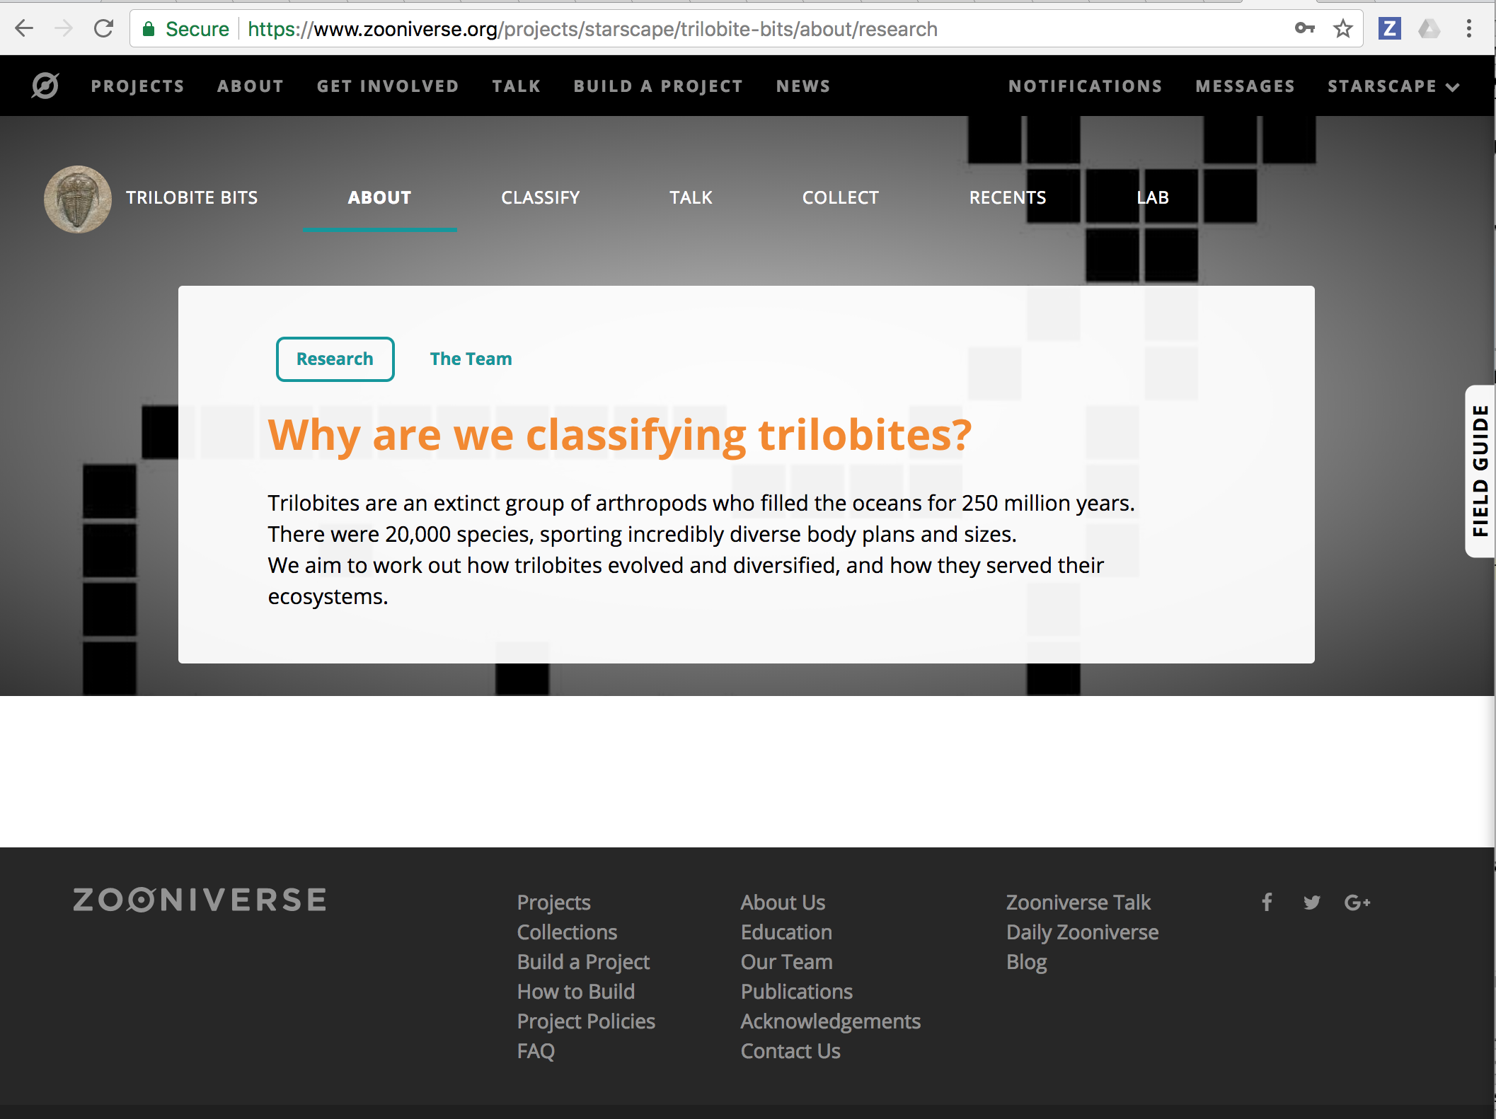

Slide 7
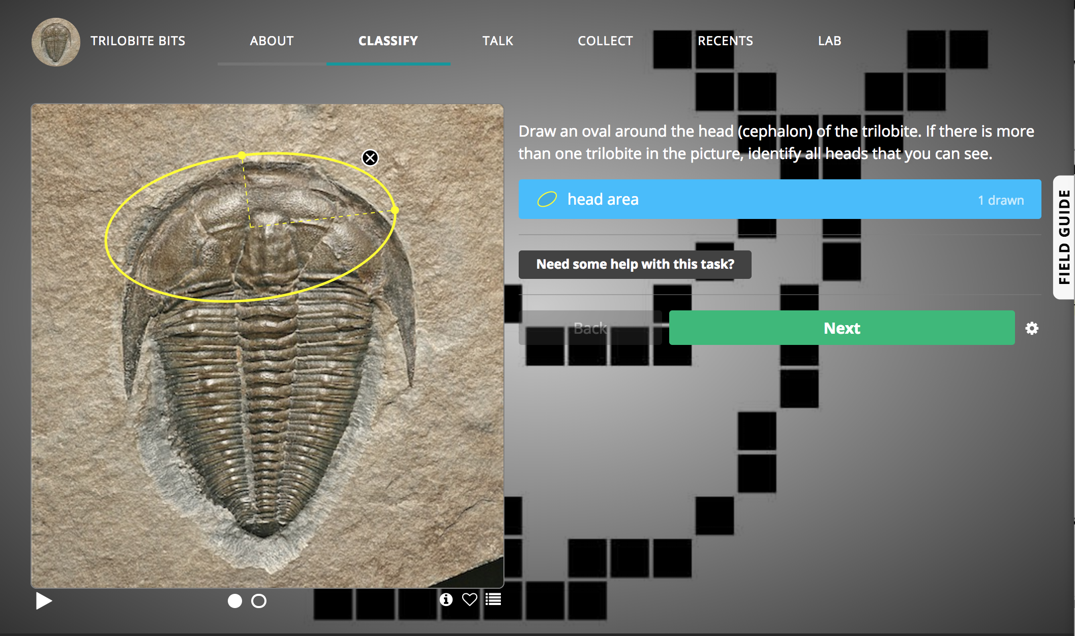
Identify head location and scale

Slide 8
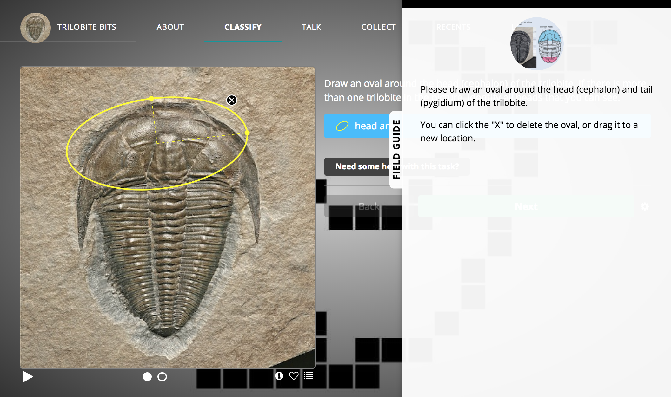
Field Guide And Tutorial

Slide 9
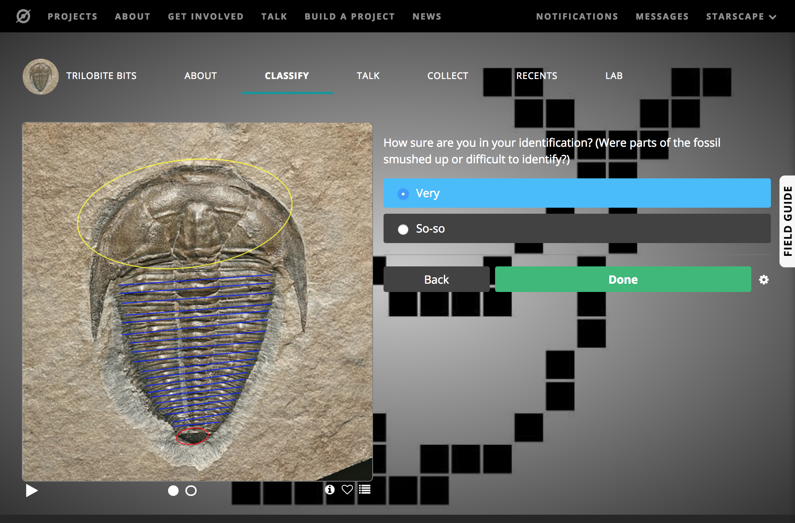
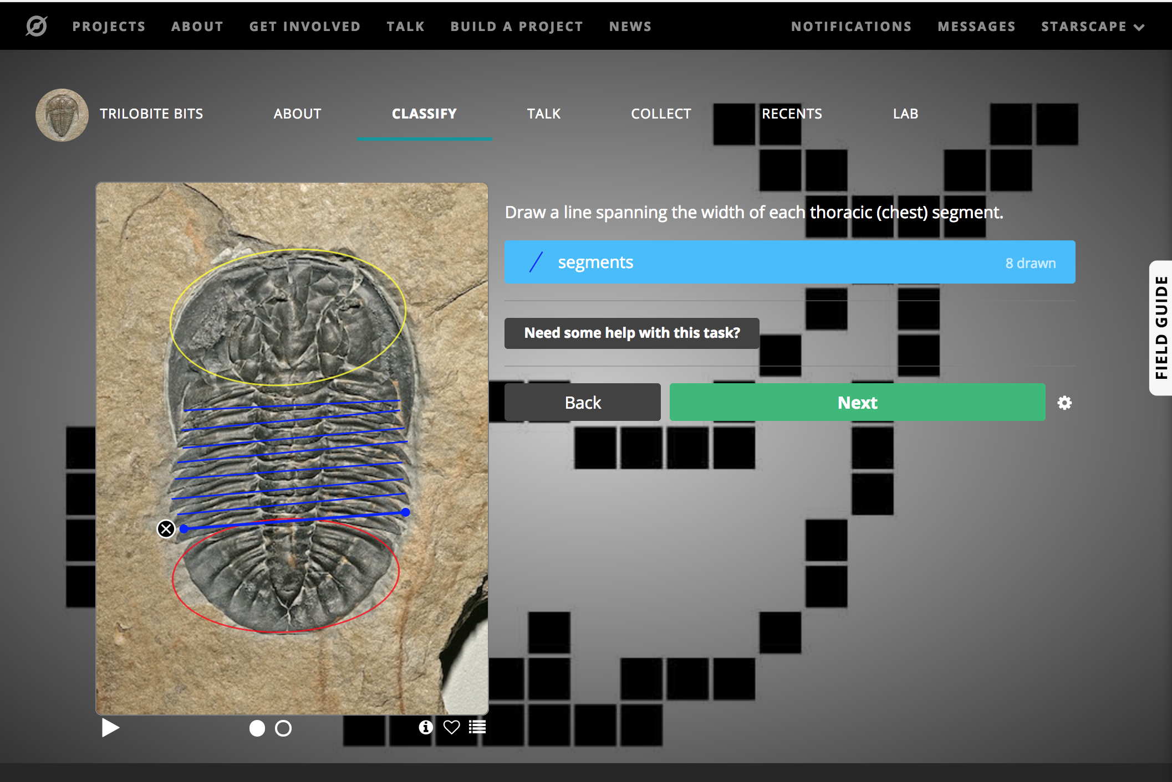
ID axes and count segments

Slide 10
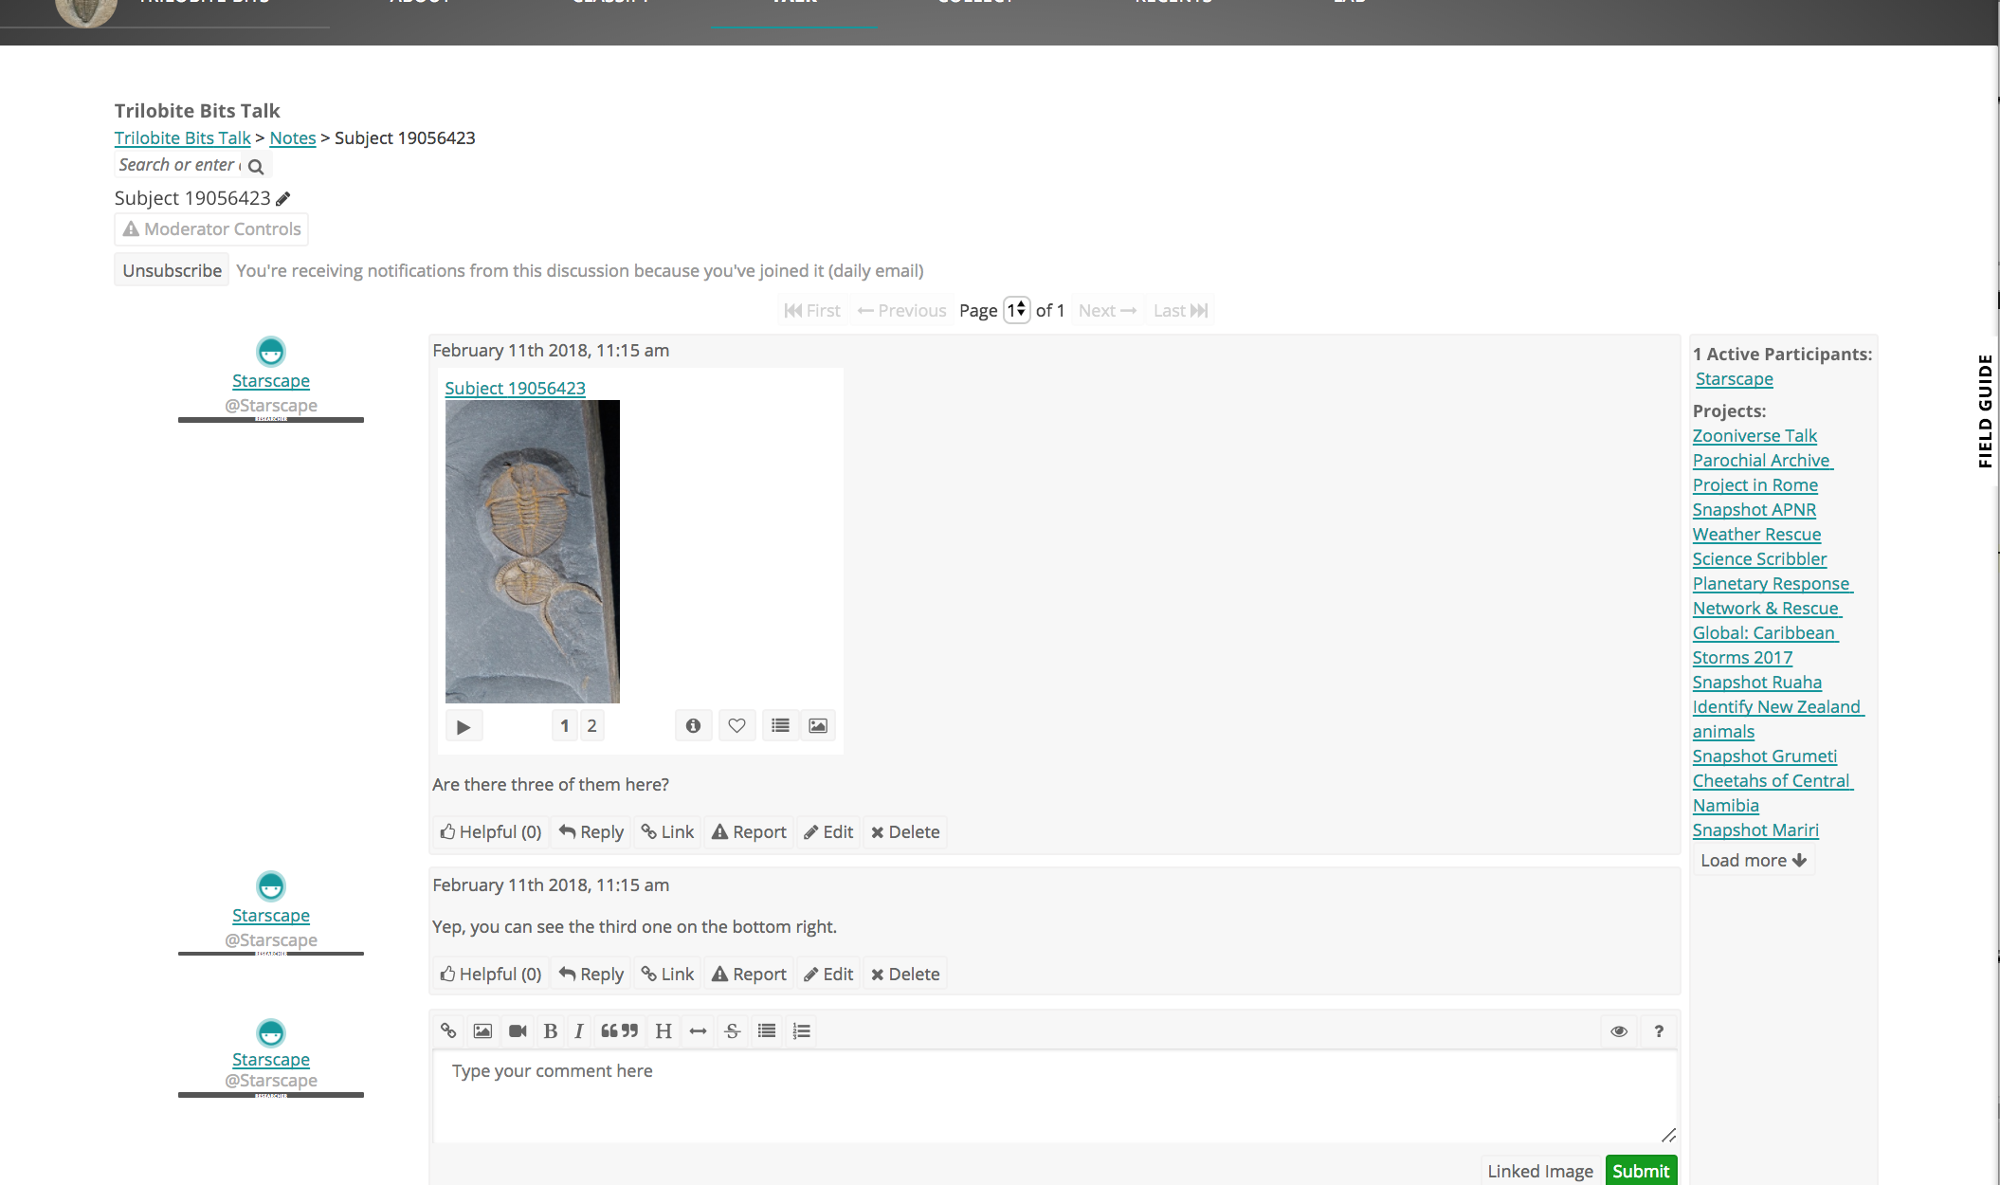
What If Wrong?

Slide 11
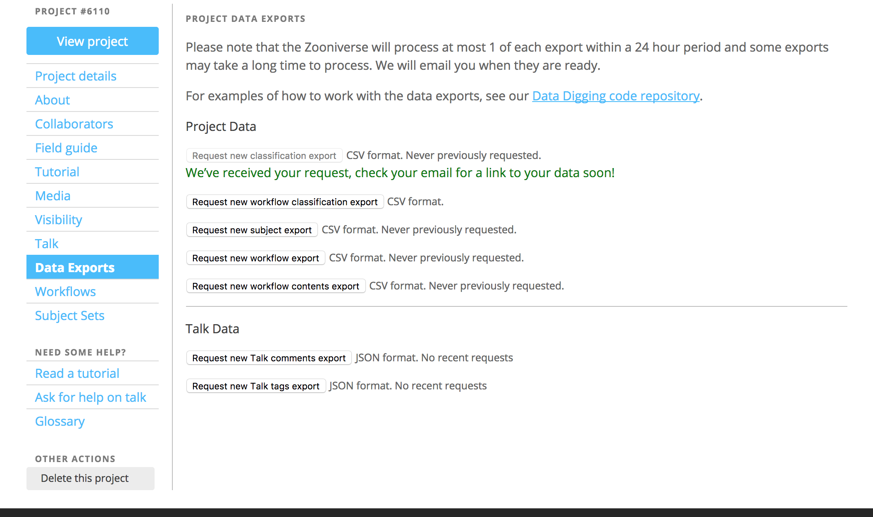
What The Scientist Gets

Slide 12
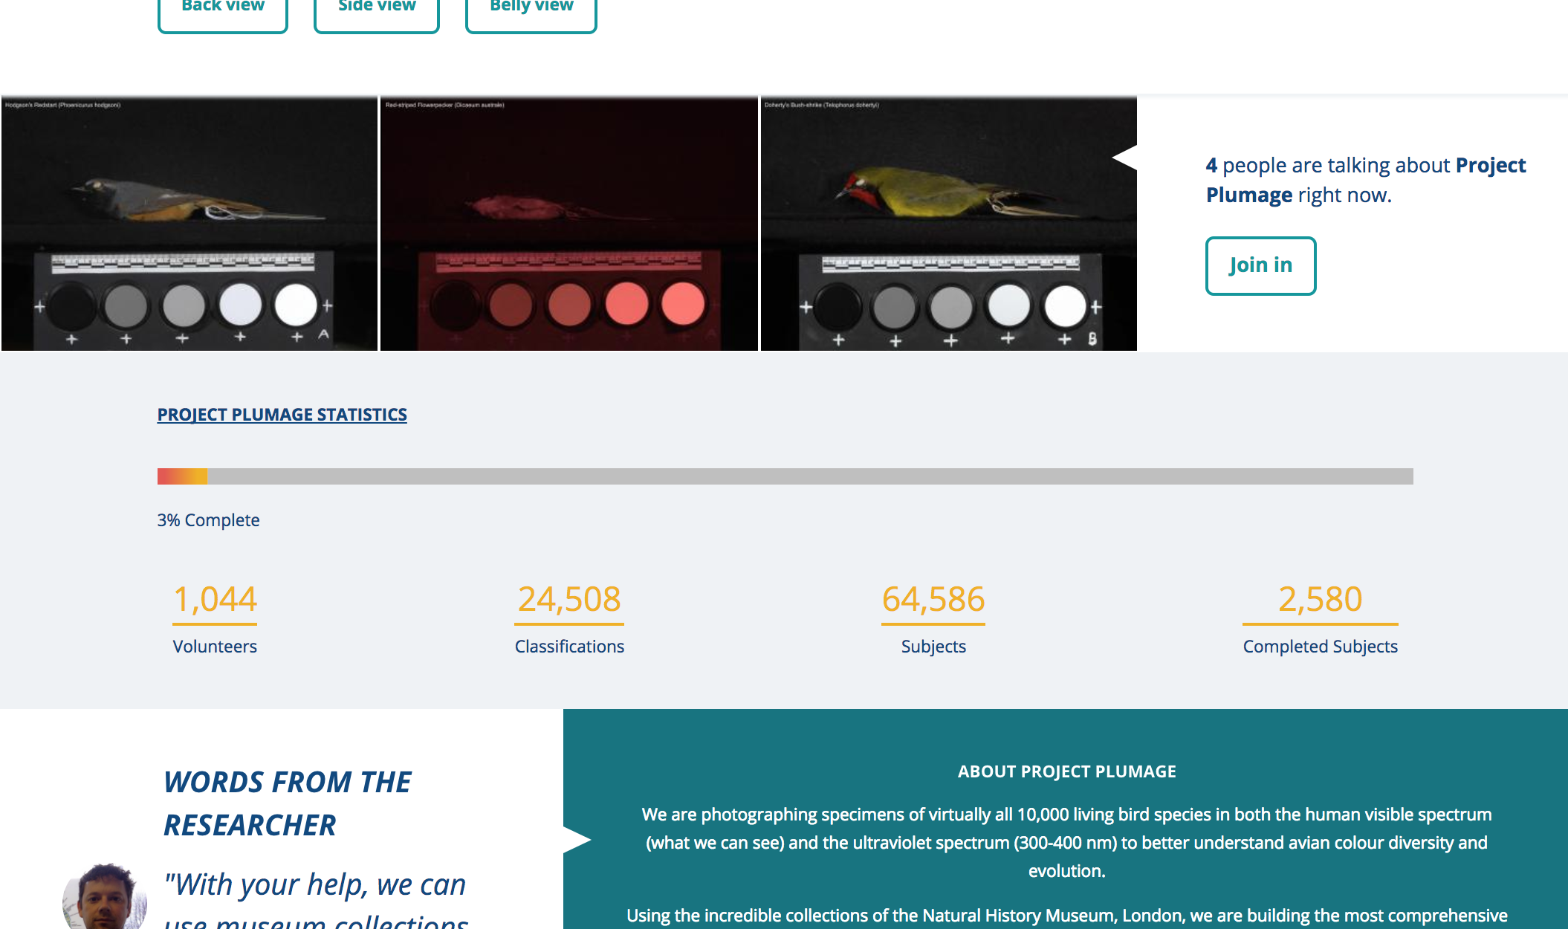
What The Scientist Gets

